Slide 1
School Name: Mary Lin
Cluster: Midtown
Principal Name: Sharyn Briscoe

Slide 2
8 years
11 years
1
STEAM
In progress
2024
N/a (<10)
631
30 students
648
198 students
17

Slide 3
Indicator | Time Frame
 | September 2021 | September 2022
Attendance Take Rate | 99.5 | 99.6
ADA Attendance Rate | 96.4 | 96.1
Students not chronically absent | 91.4 | 90.3
0.01
Subgroup | Total number of students | OSS Suspension Rate
Female | 319 | 0.02
Male | 308 | 0
SWD | 29 | 0.36
Black | 60 | 0
Hispanic | 34 | 0
Multi-race | 47 | 0
White | 468 | 0.02
Asian | 17 | 0
*As of xx/xx/2022
*As of 10/12/2022
Notes:
ACES 2.0 School culture
Restorative practices
Family engagement

Slide 5
Program | Avg. Daily Use (Mins) |  | Avg. Weekly Use (Days)
 | Spring 2022* | Fall 2022** | Spring 2022 | Fall 2022
Read 180 | 15 minutes | 17.7 | 1.4 days | 1.5 days
System 44 | 19 minutes | 12 minutes | 2 days | 1 day
iRead | 17 minutes | 14 minutes | 1 day | 1 day
*Spring 2022: From the Spring ACES presentation
**Fall 2022: As of October 13, 2022

Slide 6
 | CIP Strategy | Action Step Progress Update
ELA | We will increase the number of students who score a 3 or more in writing on the Milestones by 10%. | We have had one Write Score administration and the window is currently open for the second. The teachers and coaches analyze this data to determine which specific skills need to be retaught to improve student writing. These skills are retaught in small group providing students with specific strategies to improve their area of weakness. Then, teachers monitor progress and provide frequent feedback.
Math | We will increase the number of students who score at monitor or accelerate stage of the geometry domain on Milestones. | During intervention block, teachers are beginning to review previous grade level geometry standards by using small groups, Coach Digital, Freckle, and Number Corner (Bridges).
Whole Child & Student Support | Each student will set MAP and Milestones achievement and growth scores for themselves. The Mary Lin CARE Team will work to increase attendance and provide personalized attention to students exhibiting anxiety. | On October 10th, the teachers were trained in MAP Goal Setting from NWEA. There will be a follow up by grade level coming up on November 1st to ensure that all teachers have guided their students into setting personal growth and achievement goals.
Family Engagement | The Mary Lin administration and PTA will work together to provide ample opportunities for parents and community to come together in support and in celebration of our school. | We hosted several Back to School play dates. We have returned to in-person events such as Curriculum Night, Science Night, etc. Our first fundraiser of the year, Boosterthon, was a success and was well attended by families. We will host our first Family Movie Night on October 21st. Mary Lin volunteers will man the bounce houses at the Candler Park Fall Festival. We host bi-monthly Principal Coffees.

Slide 8
What support do you need to accomplish your SY23 goals?
We need additional support with our SWD, specifically strategies for EBD students with transitioning, and how to manage extreme behaviors.

Slide 10
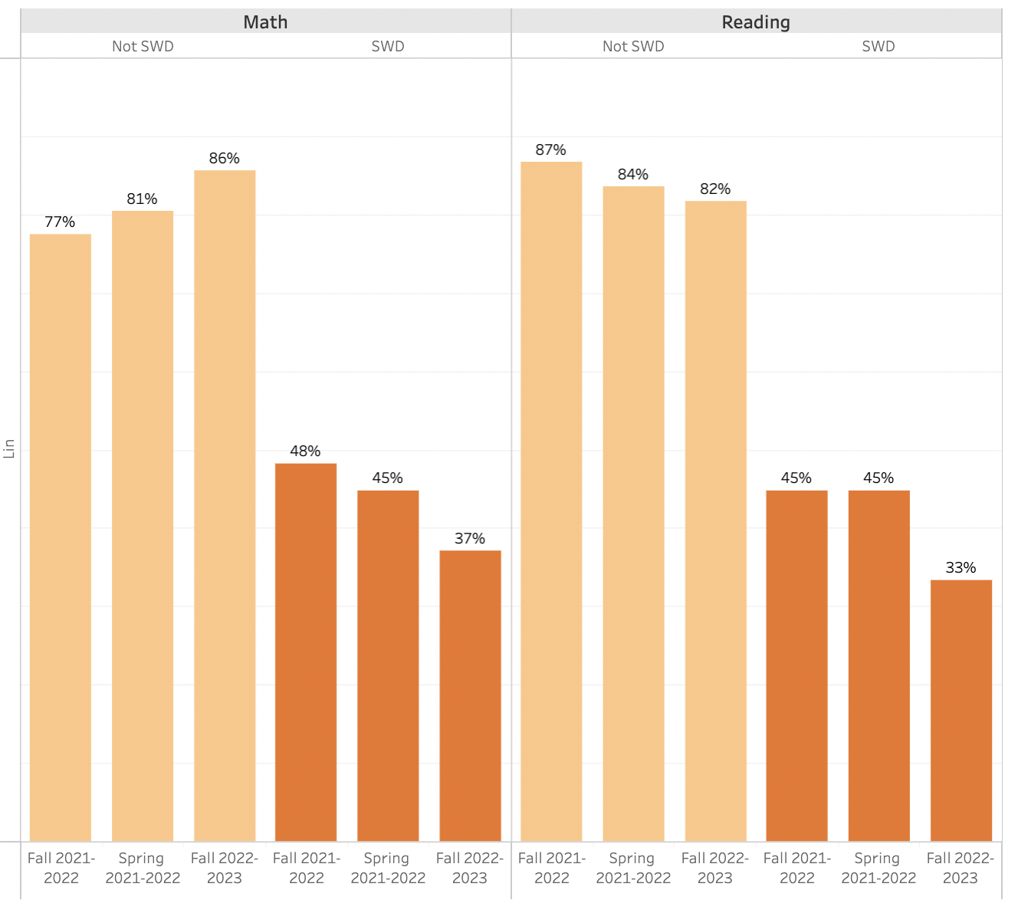

Slide 11
